Slide 1


Plates and Predictions – Forecasting Online Food Orders
Forecasting and predicting online food orders
Devadarshini P
2328M0051
Guided by
DR. R. K. Kavitha

Slide 2
ABSTRACT
This Streamlit-based dashboard, Plates and Predictions – Forecasting Online Food Orders is designed to offer comprehensive insights into online food ordering trends,
The primary goal is to enable users to analyze customer behaviour, predict future orders and assess business performance through interactive data visualizations and metrics.
This mainly targets restaurant owners, food delivery platforms and marketers looking to understand customer behaviour and optimize their operations.
Understanding customer preferences can help restaurants tailor their menus, while analyzing peak ordering times can assist in resource allocation and staff management.
This dashboard is also a powerful tool for businesses in the food delivery industry helping them optimize their operations, improve customer satisfaction and drive growth through data-driven insights.
The objectives of this project include Descriptive analysis, Predictive modelling, Customer segmentation, Operational Optimization and Customer Retention through Churn Analysis.

Slide 3
Existing System
In today’s fast-paced world, online food ordering has become an integral part of everyday life. There are a variety of existing systems available, but it has its own disadvantages too.
Drawbacks of Existing Systems:
Limited Predictive Analytics : Most existing systems focus on descriptive systems which only provides a snapshot of the past performance. There is a lack of predictive analytics.
Inadequate Customer Segmentation: Current systems often fail to perform detailed customer segmentation. Companies can optimize their operations and prevent customer retention only based on the customer behaviour. Thus, this is very crucial.
Manual Report Generation: Many systems still rely on manual processes for generating reports and insights. This approach is time-consuming, prone to errors and often results in outdates information by the time reports are produced.
Lack of Real-time analysis: Real time data analysis is essential for making quick decisions, especially during peak hours. Many existing systems are not equipped to handle real-time data processing and analysis.
The current existing systems cannot handle Large datasets.

Slide 4
Proposed System
The proposed system Plates and Predictions – Forecasting Online Food Orders is a web-based dashboard application designed to analyze and visualize online food orders.
Dataset Overview: Users can upload their own CSV file or use a default dataset to display the first few rows and total order count.
Order Distribution Analysis: Provides histograms showing the distribution of orders by day, week, month and delivery time.
Weekly Orders Prediction: Forecasts the number of orders for the upcoming week based on historical data using a simple moving average (SMA) and visualizes weekly trends.
Customer Loyalty Analysis: Analyzes customer loyalty based on the number of unique restaurants visited and total orders, categorizing customers into "Low," "Medium," and "High" loyalty groups. Also provides the top 10 loyal customers.
Key Metrics: Displays key performance indicators (KPIs) such as average delivery time, preferred payment method, peak order time and delivery/commission fees.
Top Restaurants: Visualizes the most frequently ordered restaurants using a bar chart.
Churn Analysis: Estimates the customer churn rate by identifying users who haven't placed an order in the last 180 days.
This system offers food delivery businesses valuable insights for decision-making regarding operations, customer engagement and market strategies.

Slide 5
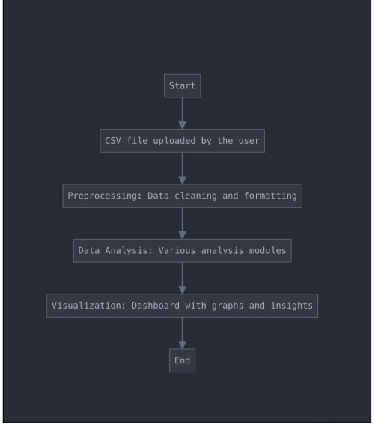
Database Design

Slide 6
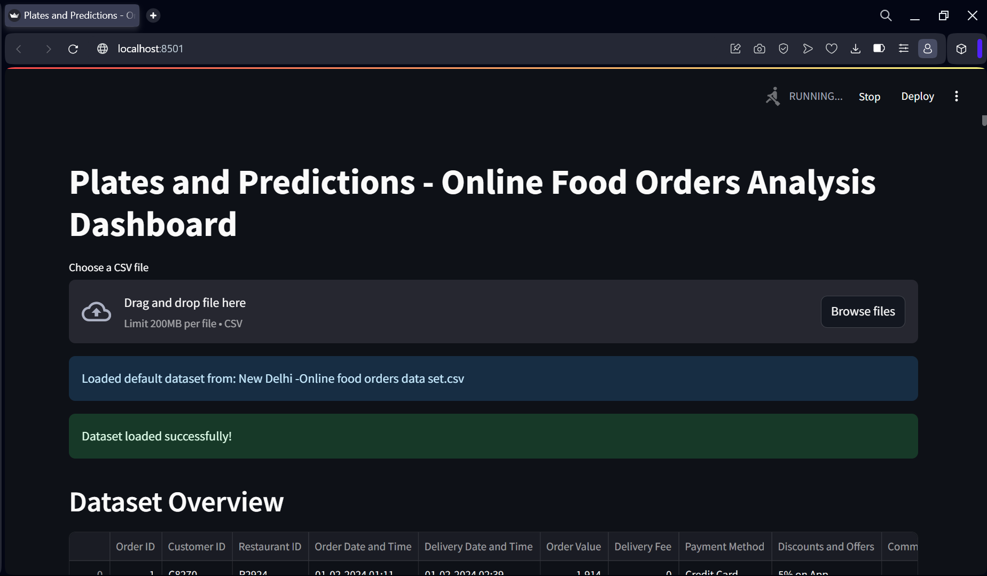
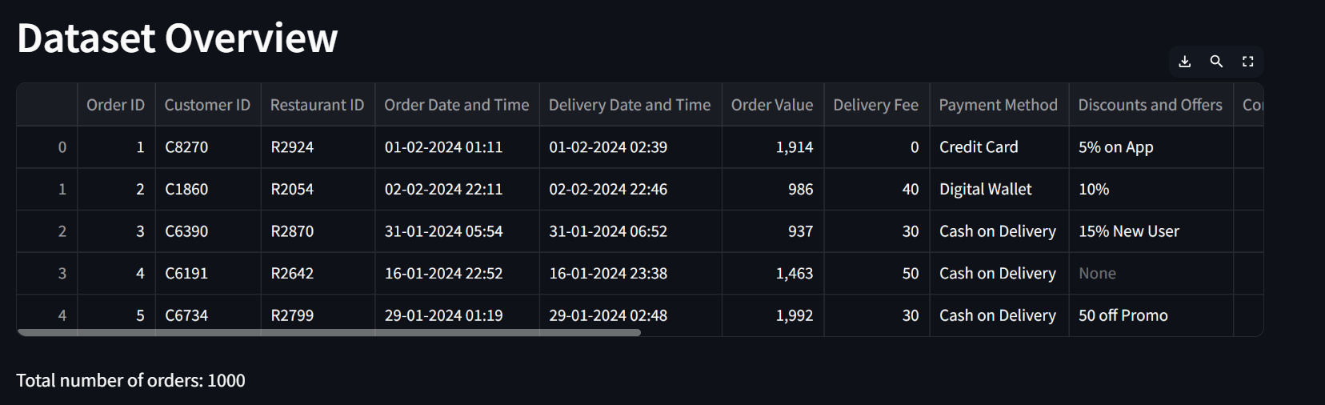
Dashboard Interface
Dataset Overview
Total number of orders: 1000

Slide 7
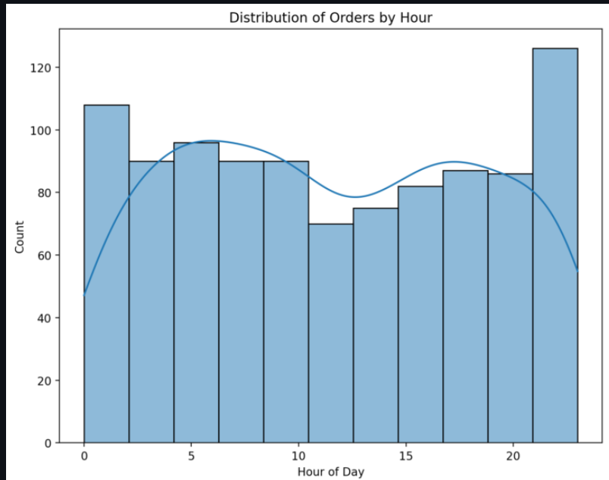
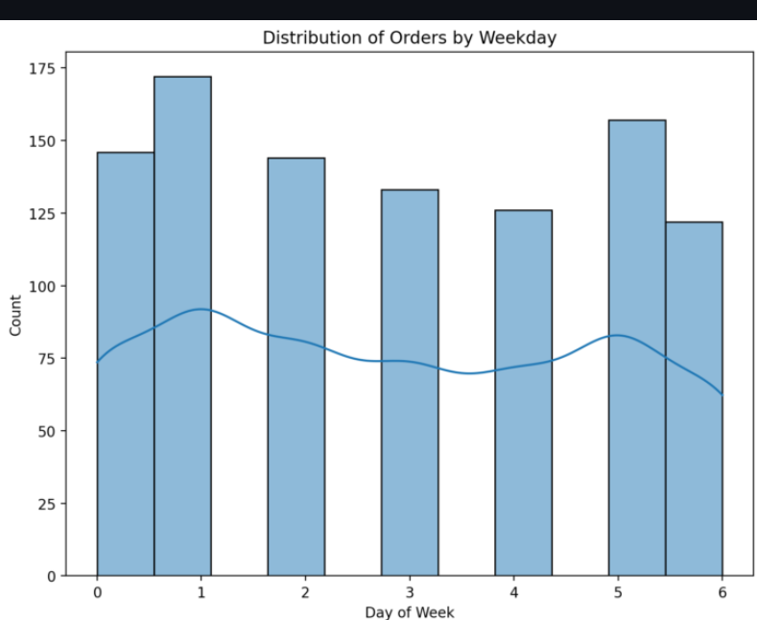
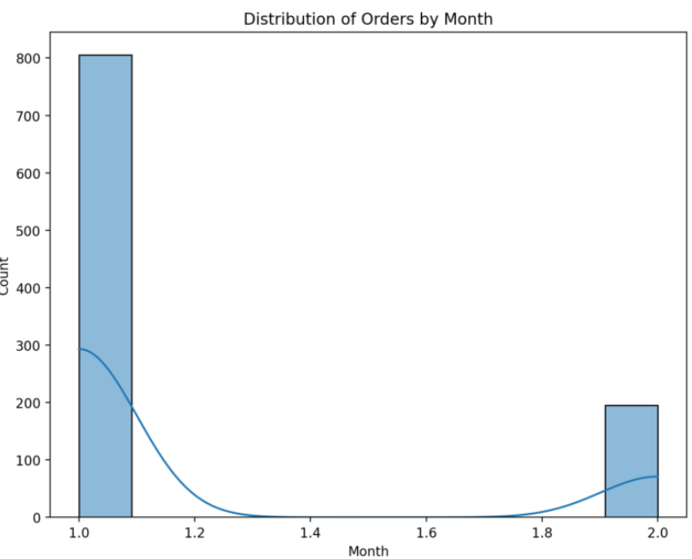
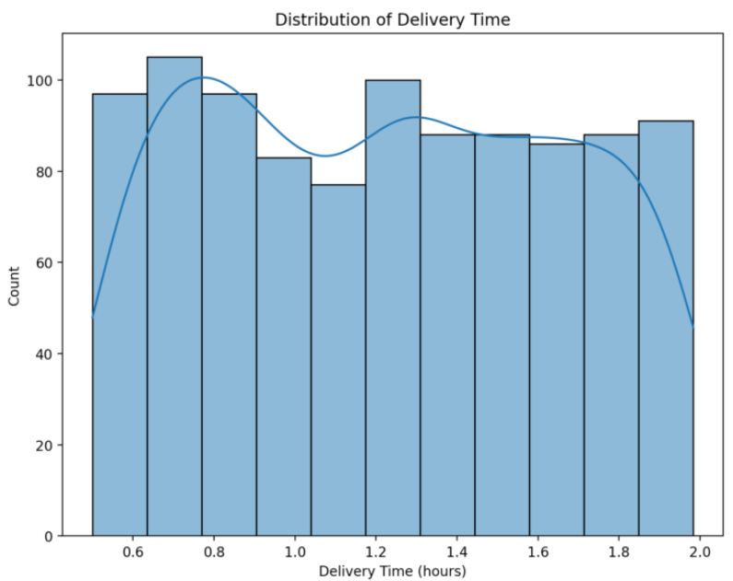

Slide 8
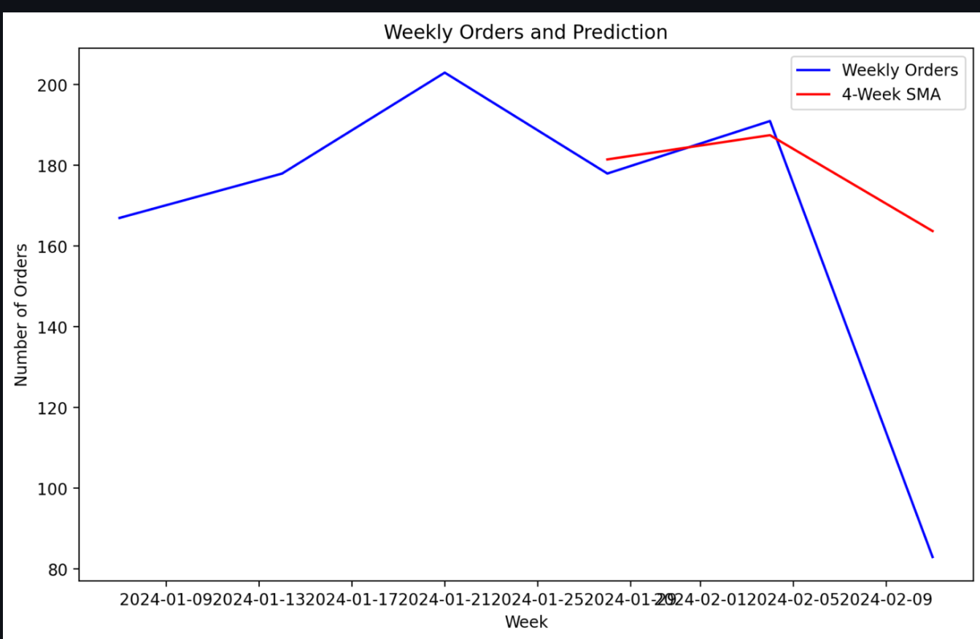
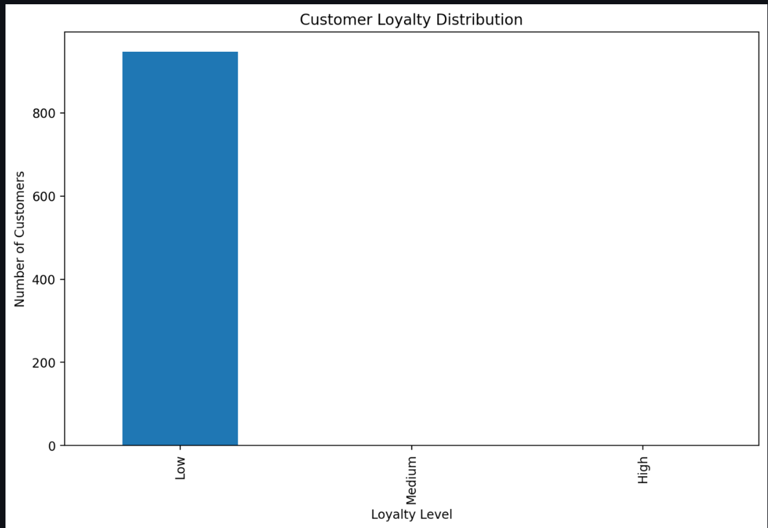
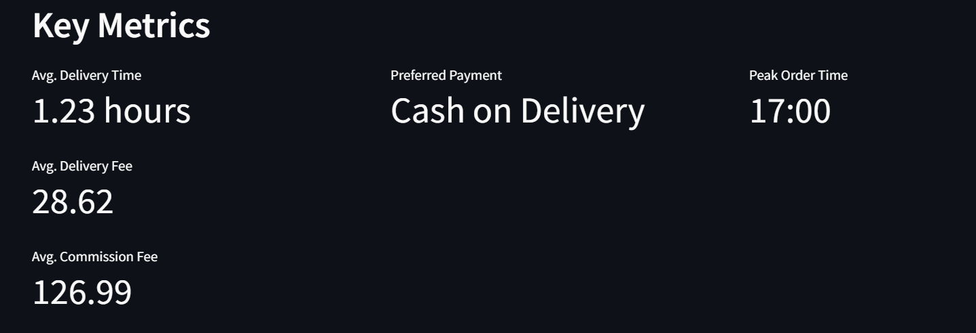
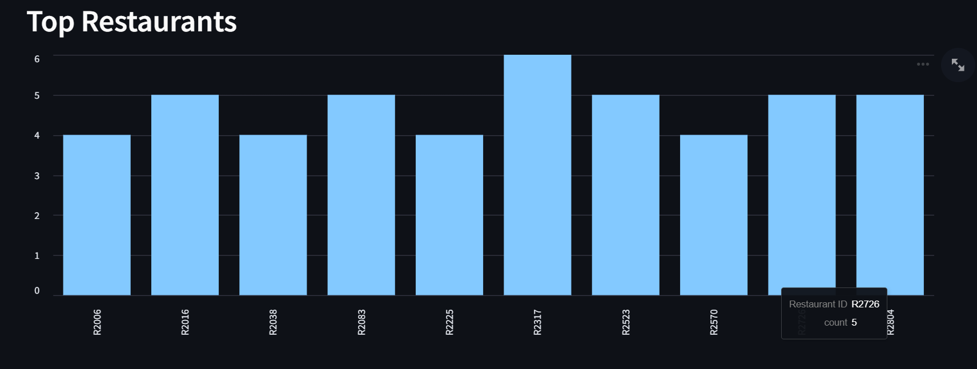

Slide 9
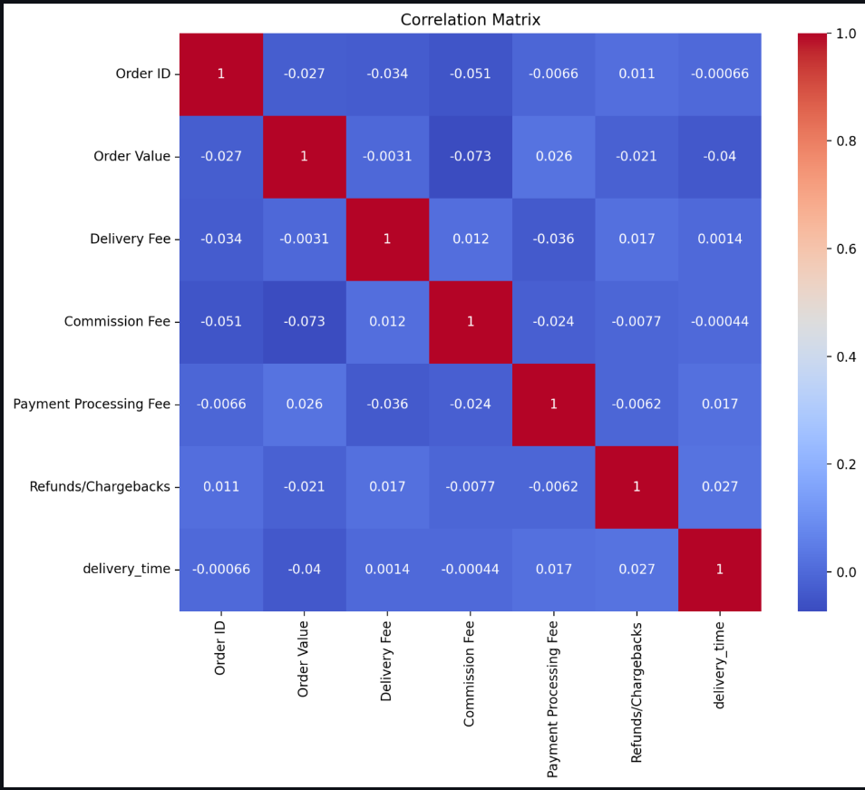
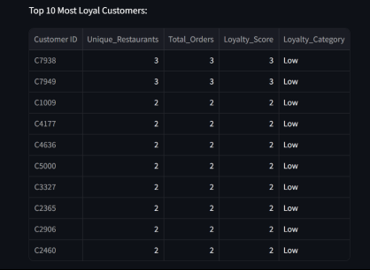
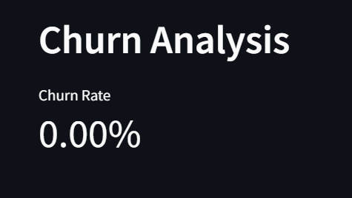

Slide 10
Conclusion and Future enhancements
The dashboard effectively visualizes key metrics and trends in online food orders, such as order patterns, customer loyalty, and delivery performance. It helps businesses understand customer behavior and optimize strategies.
Advanced Forecasting: Utilize machine learning models for better order and churn predictions.
Real-Time Data Integration: Incorporate real-time analytics for dynamic insights.
Enhanced Customer Insights: Implement segmentation and sentiment analysis for personalized marketing strategies

Slide 11
THANK YOU !
Devadarshini P
2328M0051

